Slide 1
SS ZG622:
Software Project Management
(Selection of Development Process Models)
K G Krishna, Off-Campus Centre, BITS-Pilani, Hyderabad

Slide 2
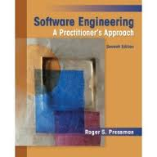

Text Books
T1: Pressman, R.S. Software Engineering : A Practitioner’s Approach, 7th Edition, TMH, 2010
T2: Hughes, B and Cotterel, M., Software Project Management, 11th Edition, TMH, 2011
S1: Frank Tsui, Managing Software Projects, Jones&Bartlett, 2011
S2: Pankaj Jalote, Software Project Management in Practice, Pearson Education, 2002
Note: In order to broaden understanding of concepts as applied to Indian IT industry, students are advised to refer books of their choice and case-studies in their own organizations

Slide 3
Selecting the Right Development Process Model for the Project
Source Courtesy: Some of the contents of this PPT are sourced from materials provided by Publishers of T1 & T2

Slide 4
Project Evaluation: Summary
A project may fail not through poor management but because it should never have been started
A project may make a profit, but it may be possible to do something else that makes even more profit
A real problem is that it is often not possible to express benefits in accurate financial terms
Projects with the highest potential returns are often the most risky

Slide 5
Selection of Project Approach
(Development Model)
Building versus buying software
Taking account of the characteristics of the project
Process models
  Waterfall
  Prototyping and iterative approaches
  Incremental delivery
Agile methods
Notes:
It can be argued that agile approaches are often a repackaging of prototyping and incremental delivery.

Slide 6
Selection the Right Model for Development
Choosing the right approach to a particular project:
  technical planning, project analysis, methods engineering / custom models
In-house: often the methods to be used dictated by organizational standards
Vendors: need for tailoring as different customers have different needs
Notes:
Section 4.1 and 4.3 of the textbook discuss these issues. Different types of project need different types of approach. If you are working in one particular environment which specializes in one type of software, then the approach is likely not to change much from one project to another. Where you work for different clients in different organizations developing a variety of applications then the approach for each project may need to be tailored.

Slide 7
Build or Buy?
In-house
development?
Outsource?
either
Build
Buy
Notes:
In-house development almost always involves developing new code.
If it is decided to use a specialist organization to implement system, the supplier could either build a ‘bespoke’ system for you, or could install a pre-existing application. There are hybrids of these options, e.g. to build in-house but use temporary contract staff, or Customised Off-the-Shelf (COTS) where a basic existing core system is modified for your particular requirements.

Slide 8
Some advantages of off-the-shelf (OTS) software
Cheaper as supplier can spread development costs over a large number of customers
Software already exists
  Can be used by potential customer
  No delay while software being developed
Where there have been existing users, bugs are likely to have been found and eradicated

Slide 9
Some possible disadvantages of OTS software products
Customer will have same application as everyone else: no competitive advantage, but competitive advantage may come from the way application is used
Customer may need to change the way they work in order to fit in with OTS application
Customer does not own the code and cannot change it
Danger of over-reliance on a single supplier
Notes:
One concern is what happens if the supplier goes out of business. Customer might not then be able to maintain system: hence the use of ‘escrow’ services where a 3rd party retains a copy of the code.

Slide 10
General Guidelines:
Look at risks and uncertainties e.g.
  are requirement well understood?
  are technologies to be used well understood?
Look at the type of application being built e.g.
  information system? embedded system?
  criticality? differences between target and development environments?
Clients’ own requirements
  need to use a particular method
Notes:
See section 4.3 of the textbook.

Slide 11
Structured Development vs.
Speed of Delivery
Structured approach:
  Also called ‘heavyweight’ approaches
  Step-by-step methods where each step and intermediate product is carefully defined
  Emphasis on getting quality right first time
  Example: use of UML
  Future vision: Model-Driven Architecture (MDA) --UML supplemented with Object Constraint Language, press the button and application code generated from the UML/OCL model (?)

Slide 12
Structure vs. Speed
Agile methods (for speed)
  Emphasis on speed of delivery rather than documentation
RAD (Rapid application development)
  emphasizes use of quickly developed prototypes

Slide 13
Basic Choice of Process Models
Waterfall (‘heavy-weight’)
Incremental delivery
Evolutionary development
Or
use of ‘agile methods’ e.g. extreme programming / Scrum Frameworks
Notes:
It could be argued that extreme programming is mainly a particular way of carrying out incremental and evolutionary development

Slide 14
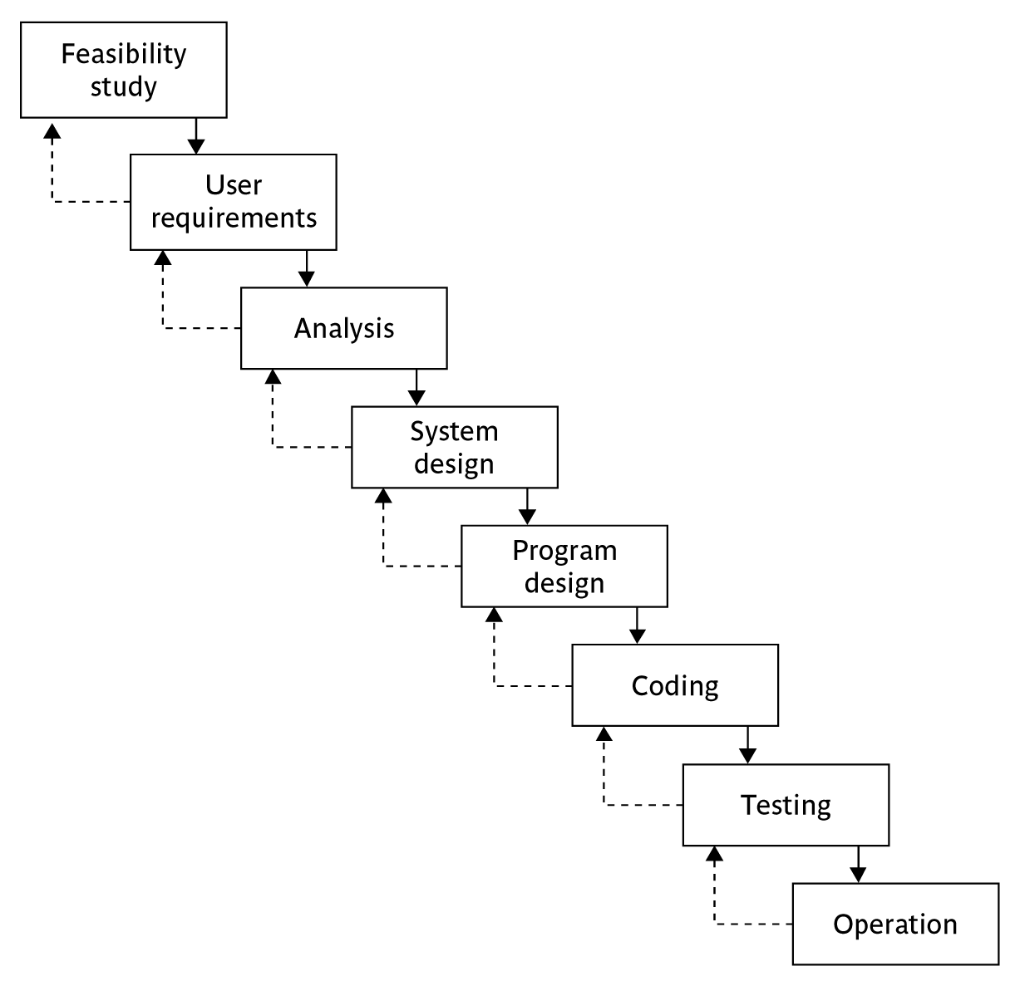
Waterfall Model
Notes:
Section 4.6 of the textbook discusses this topic.
We have already touched upon the Waterfall approach in Lecture/Chapter 1 when we discussed the ISO 12207. The way that the Waterfall approach is usually interpreted, it implies that all work on one phase has to be completed and checked off before the next one can start. However, it can be argued that ISO 12207 is really a technical model showing the order technical processes need to be carried out on a software component. You might break down an application into component increments, but the technical processes relating to that increment are carried out in the ISO 12207 sequence. You can, within the ISO 12207 sequence, loop back in an iterative manner, but the technical sequence still remains.

Slide 15
Waterfall
the ‘classical’ model
imposes structure on the project
every stage needs to be checked and signed off
BUT
  limited scope for iteration
V model approach is an extension of waterfall where different testing phases are identified which check the quality of different development phases

Slide 16
Evolutionary delivery: prototyping
‘ An iterative process of creating quickly and inexpensively live and working models to test out requirements and assumptions’
  ‘throw away’ prototypes
  evolutionary prototypes
  what is being prototyped?
  human-computer interface
  functionality

Slide 17
Reasons for prototyping
learning by doing
improved communication
improved user involvement
a feedback loop is established
reduces the need for documentation
reduces maintenance costs i.e. changes after the application goes live
prototype can be used for producing expected results
Notes:
A prototype is a working model of one or more aspects of the project application. It is constructed quickly and inexpensively in order to test out assumptions.
Sections 4.9, 4.10 and 4.11 discuss this topic.
learning by doing - useful where requirements are only partially known
improved communication - users are reluctant to read massive documents, but when system is ‘live’ you get a better feeling for it
improved user involvement - user ideas and requests are quickly implemented
the reduction of maintenance costs – the idea is that if you do not have a prototype then the first release of the application will effectively become a prototype as users will find things that they do not like and then ask for them to be changed. It is easier and safer to make such changes before the application becomes operational.
testing - involves devising test cases and then documenting the results expected when the test cases are run. If these are done by hand, then effectively you have a manual prototype. Why not get the software prototype to generate the expected results?

Slide 18
Prototyping: some dangers
users may misunderstand the role of the prototype
lack of project control and standards possible
additional expense of building prototype
focus on user-friendly interface could be at expense of machine efficiency

Slide 19
Categories of Prototypes
Throw-away Prototypes
  ‘experimental’ (HW/SW prototype)
  ‘exploratory’ (application prototype)
Re-usable Prototype
  ‘evolutionary’ build (for continuous feedback)
  Final prototype = Deliverable!
Notes:
When a prototype is to be produced as part of a student’s final year project, then the learning objectives that the prototypes will help be achieved need to defined at project inception. The details of what has been learnt through the development and exercising of the prototype should be documented during the project.

Slide 20



Incremental delivery
delivered
system
increment
1
first incremental delivery
increment
2
second incremental delivery
increment
3
third incremental delivery
Notes:
The application to be delivered is broken down into a number of components each of which will be actually used by the users. Each of these is then developed as a separate ‘mini-project’ or increment.

Slide 21
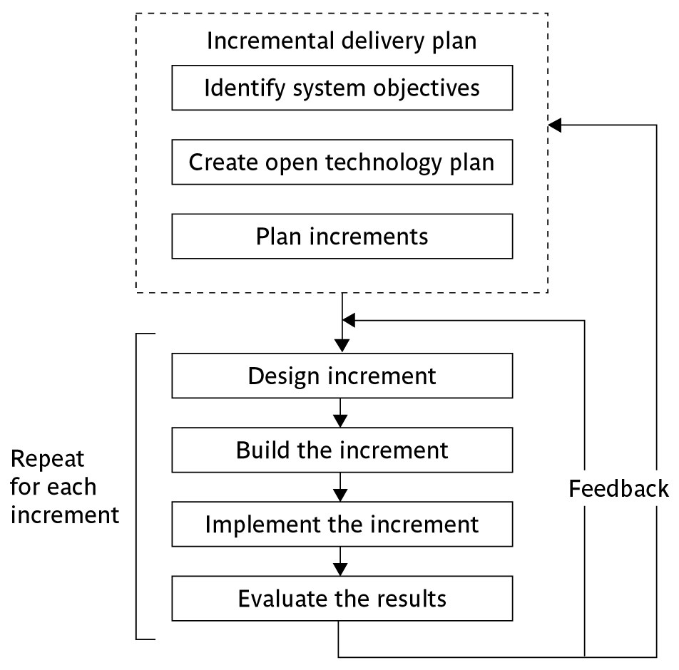
The incremental process
Notes:
This approach has had a very vocal advocate in Tom Gilb (see the book Principles of Software Engineering Management published by Addison-Wesley (1988)).
Gilb argues that the initial focus should be on high level business objectives. There may be many ways in which important objectives can be achieved and we ought to allow ourselves freedom in the way we try to achieve the objectives.
Open technology plan – we need to ensure that the technologies we use are ones that facilitate the addition of components to an existing application.
Plan increments – the nature and order of the increments to be delivered needs to be delivered to the users have to be planned at the outset.

Slide 22
Incremental approach: benefits
feedback from early stages used in developing latter stages
shorter development thresholds
user gets some benefits earlier
project may be put aside temporarily
reduces ‘gold-plating’:
BUT there are some possible disadvantages
loss of economy of scale
‘software breakage’
Notes:
Advantages of prototyping
feedback from early stages used in developing latter stages
shorter development thresholds - important when requirements are likely to change
user gets some benefits earlier - may assist cash flow
project may be put aside temporarily - more urgent jobs may emerge
reduces ‘gold-plating’ i.e. features requested but not used
But there are possible disadvantages
loss of economy of scale - some costs will be repeated
‘software breakage’ - later increments might change earlier increments

Slide 23
Incremental planning
steps ideally 1% to 5% of the total project
ideal if a step takes one month or less:
  not more than three months
each step should deliver some benefit to the user
some steps will be physically dependent on others

Slide 24
‘Agile’ methods
structured development methods have some perceived advantages
  produce large amounts of documentation which can be largely unread
  documentation has to be kept up to date
  division into specialist groups and need to follow procedures stifles communication
  users can be excluded from decision process
  long lead times to deliver anything etc. etc
The answer? ‘Agile’ methods!

Slide 25
Time-boxing
time-box fixed deadline by which something has to be delivered
typically two to six weeks
MOSCOW priorities
  Must have - essential
  Should have - very important, but system could operate without
  Could have
  Want - but probably won’t get!
Notes:
Time-boxes mean that the focus moves from having a fixed set of functional requirements and then extending the planned project completion until they have all been developed. The deadline is fixed and we deliver what we have completed so far even if it is not everything that was originally planned.
In order to make the delivered package coherent and as useful as possible to the users, requirements are prioritized according to the MoSCoW rules.

Slide 26
Extreme Programming (XP)
increments of one to three weeks
  customer can suggest improvement at any point
argued that distinction between design and building of software are artificial
code to be developed to meet current needs only
frequent re-factoring to keep code structured
developers work in pairs
test cases and expected results devised before software design
after testing of increment, test cases added to a consolidated set of test cases
Notes:
Associated with Kent Beck - see Extreme programming explained
Developed originally on Chrysler C3 payroll (Smalltalk) project
Agile methods include Jim Highsmith’s Adaptive Software Development and Alistair Cocburn’s Chrystal Lite methods

Slide 27
Limitations of XP
Reliance on availability of high quality developers
Dependence on personal knowledge – after development knowledge of software may decay making future development less easy
Rationale for decisions may be lost e.g. which test case checks a particular requirement
Reuse of existing code less likely

Slide 28
‘Conceptual integrity sometimes suffers because there is little motivation to deal with scalability, extensibility, portability, or reusability beyond what any vague requirement might imply’
  - Grady Booch (Authority on OO)

Slide 29
A Combination of approaches?
installation
waterfall
incremental
evolutionary
waterfall
yes
yes
no
construction
incremental
yes
yes
no
evolutionary
yes
yes
yes
waterfall or incremental installation – any construction approach possible
evolutionary installation implies evolutionary construction

Slide 30
Summary: ‘rules of thumb’ about which approach to be used
IF uncertainty is high
  THEN use evolutionary approach
IF complexity is high but uncertainty is not
  THEN use incremental approach
IF uncertainty and complexity both low
  THEN use Water-fall model
IF schedule is tight
  THEN use evolutionary or incremental

Slide 31
Thank You

